Slide 1
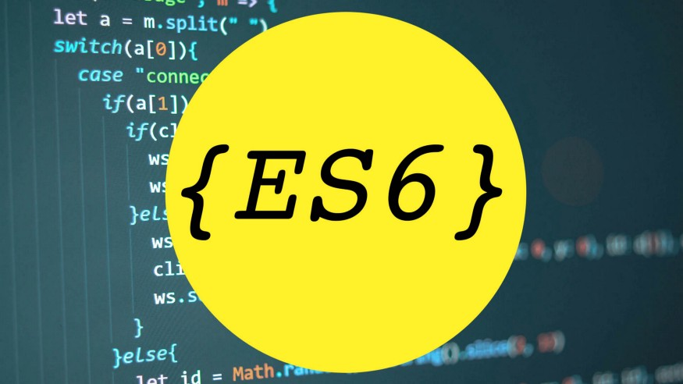
Introduction to ES6

Slide 2
What’s ES6?
ECMAScript 6 was the second major revision to JavaScript.
ECMAScript 6 is also known as ES6 and ECMAScript 2015.

Slide 3

Topics being covered.
Let and Const.
This keyword
Fat arrow function.
Spread operator.

Slide 4
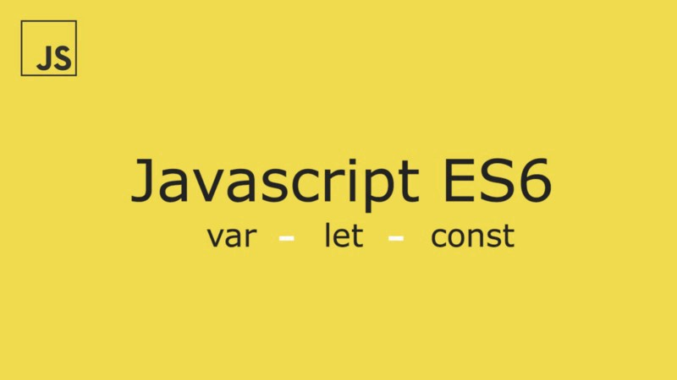
Let and Const.
The let keyword allows you to declare a variable with block scope.
The const keyword allows you to declare a constant (a JavaScript variable with a constant value).

Slide 5
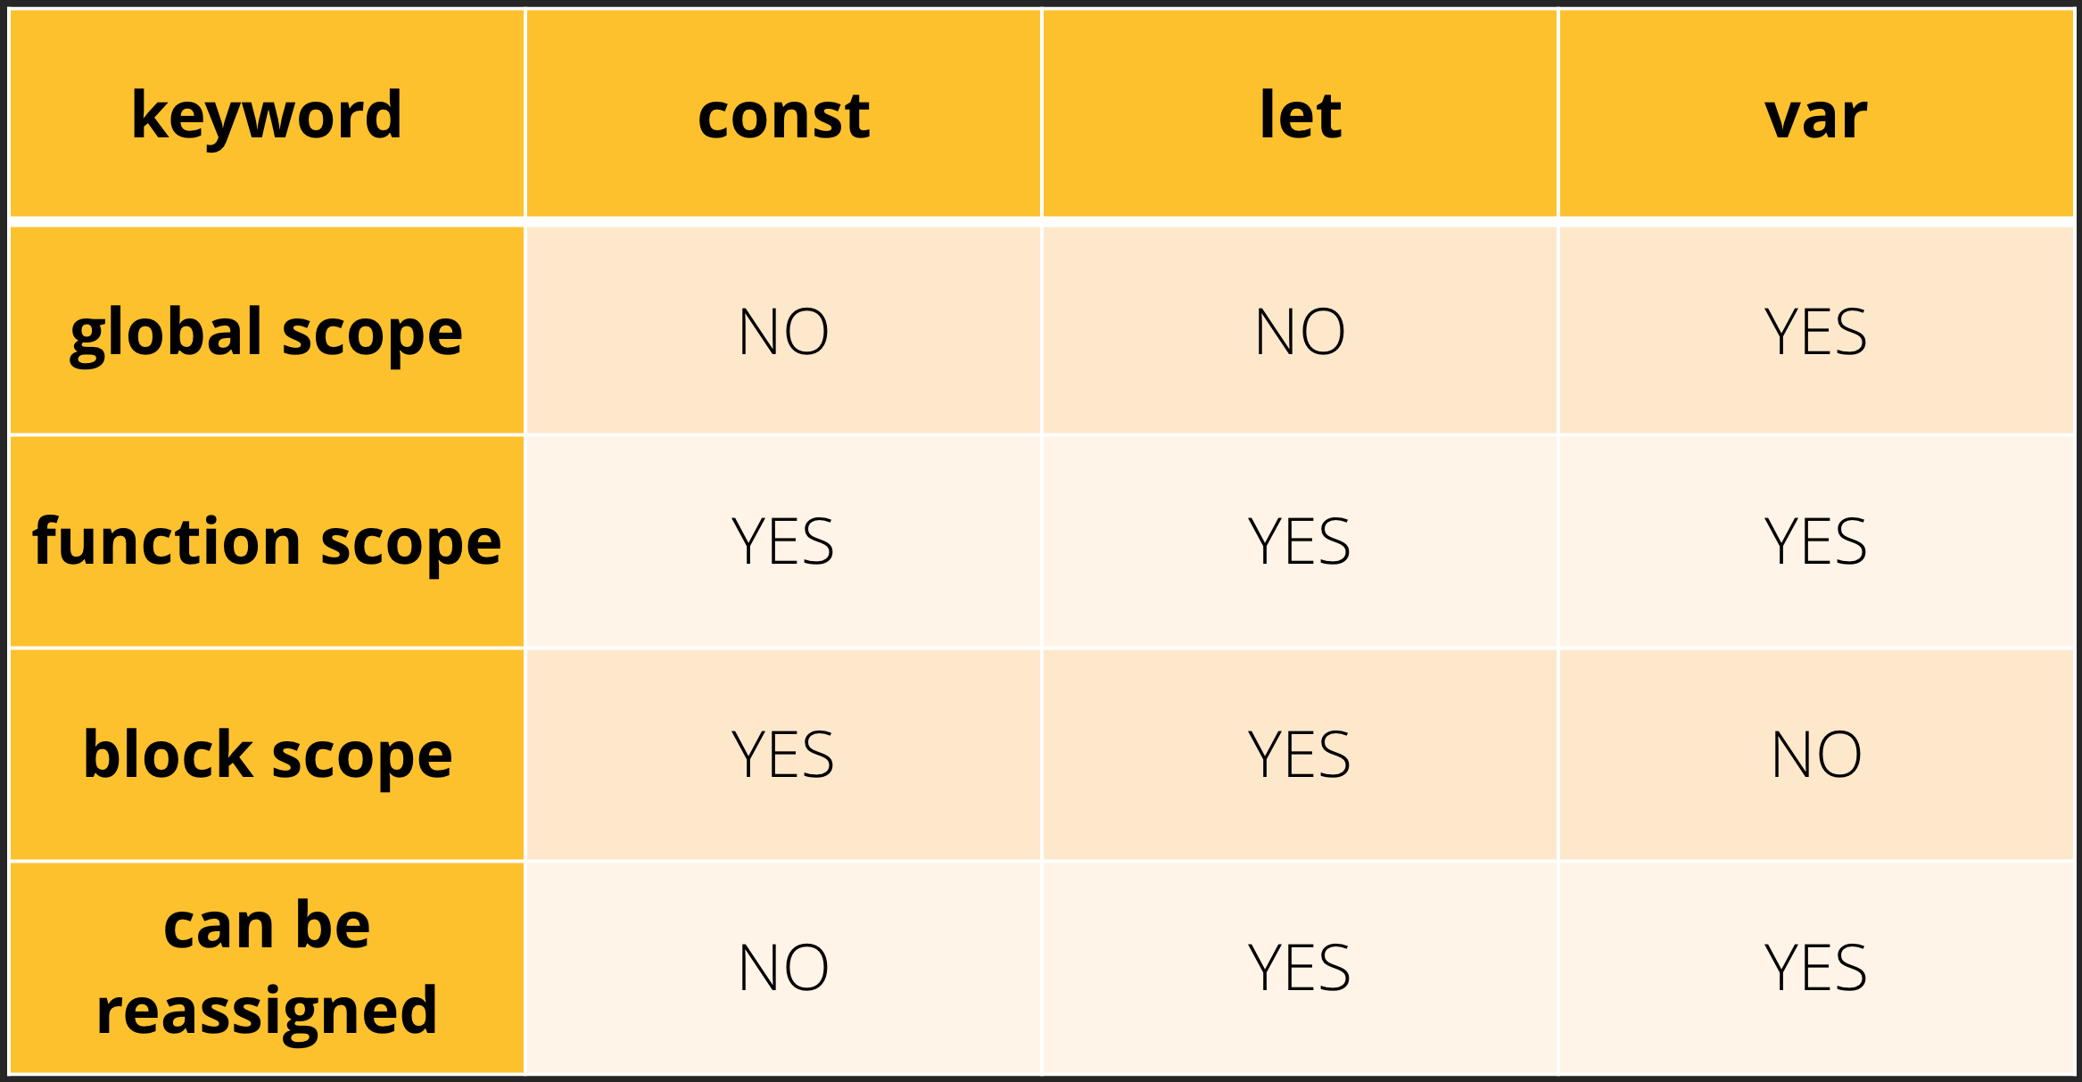

Slide 6

What is This?
The JavaScript this keyword refers to the object it belongs to.

Slide 7
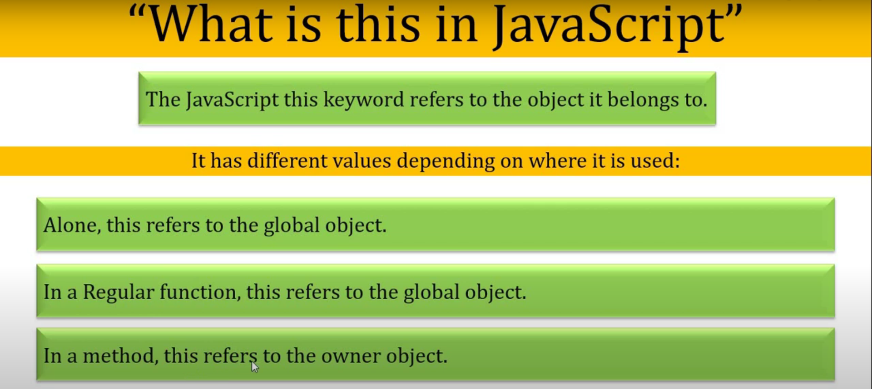

Slide 8
The FatArrow.
Arrow functions were introduced in ES6.
Arrow functions allow us to write shorter function syntax.
It gets shorter! If the function has only one statement, and the statement returns a value, you can remove the brackets and the return keyword.

Slide 9


Slide 10
Spread Operator
Spread operator allows an iterable to expand in places where 0+ arguments are expected. It is mostly used in the variable array where there is more than 1 values are expected. It allows us the privilege to obtain a list of parameters from an array. Syntax of Spread operator is same as Rest parameter but it works completely opposite of it.

Slide 11
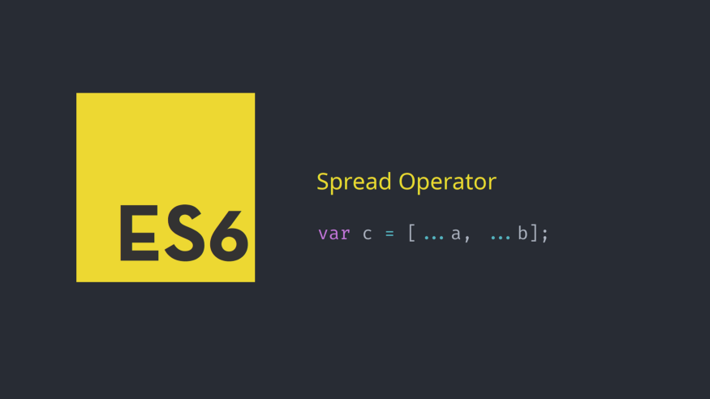

Slide 12
The end.
Thanks for watching.

